Slide 1
Applied Physics(C. Sc.) BS CS Semester-I Course Code: L-13(Thermometers and Temperature Scales) IUB & All Affiliated Colleges. Reality Awards Boost Up (YT-Channel)
Rushmat Ali.
Assistant Professor of Physics
Govt. Kh. F. Graduate College R. Y, Khan

Slide 2
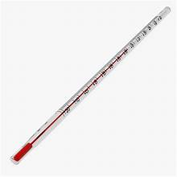
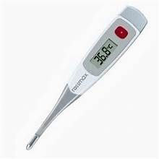
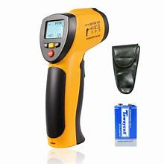
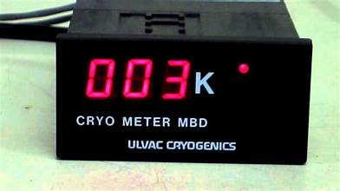
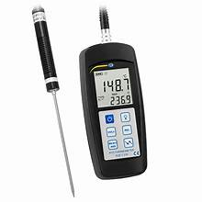
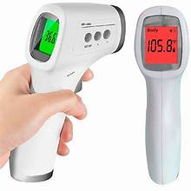
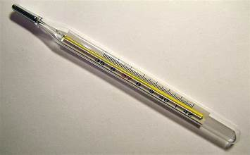
Thermometer:
A thermometer is a device that measures temperature or temperature gradient (the rates of change of temperature in space).
A thermometer has two important elements:
(1) Temperature Sensor: The bulb of a mercury-in-glass thermometer or the pyrometric sensor in an infrared thermometer) in which some change occurs with a change in temperature;
(2) Readout Mechanism: Numerical value (e.g. the visible scale or the digital readout on an infrared model).
Types of thermometers: 1. Touch, or contact, thermometers, 2. Remote, or non-contact.
Applications: Thermometers are widely used in technology and industry to monitor processes, in meteorology, in medicine (medical thermometer), and in scientific research. Thermometers are used in roadways in cold weather climates to help determine if icing conditions exist and indoors in climate control systems.
Special Types of Thermometers:
1. A cryometer: These are a thermometer used to measure very low temperatures of objects. Ethanol-filled thermometers are used in preference to mercury for meteorological measurements and can measure temperatures in the range of -38 to 70 °C (-36 to 94 °F). Their physical limitation is freezing/boiling of liquid
Types: 1.Thermocouples (1 K), 2. Vapour Pressure Thermometers (0.5K), 3. Resistance thermometers (0.01 K), 4. Melting Curve Thermometers (0.001K - 0.5K), 5. Resistance Noise Thermometers (0.001K), 6. Magnetic Thermometers ( 0.001 K), etc.

Slide 3
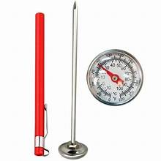

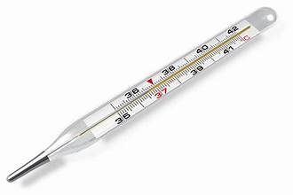
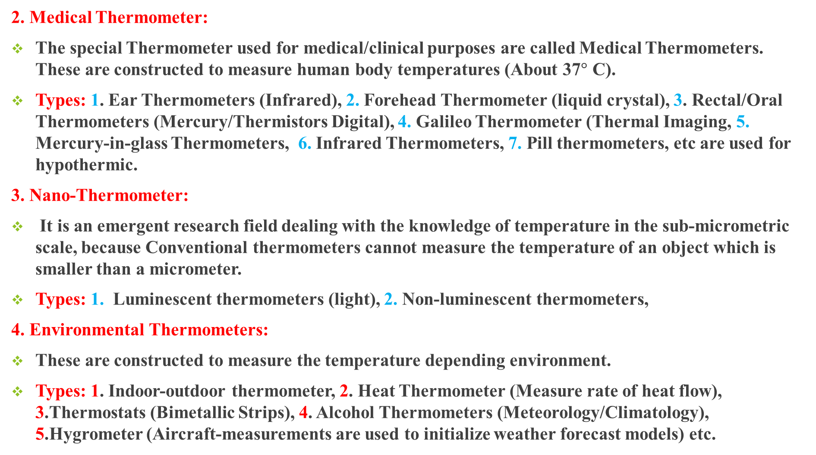
Thermometer:
2. Medical Thermometer:
The special Thermometer used for medical/clinical purposes are called Medical Thermometers. These are constructed to measure human body temperatures (About 37$°$ C).
Types: 1. Ear Thermometers (Infrared), 2. Forehead Thermometer (liquid crystal), 3. Rectal/Oral Thermometers (Mercury/Thermistors Digital), 4. Galileo Thermometer (Thermal Imaging, 5. Mercury-in-glass Thermometers, 6. Infrared Thermometers, 7. Pill thermometers, etc are used for hypothermic.
3. Nano-Thermometer:
It is an emergent research field dealing with the knowledge of temperature in the sub-micrometric scale, because Conventional thermometers cannot measure the temperature of an object which is smaller than a micrometer.
Types: 1. Luminescent thermometers (light), 2. Non-luminescent thermometers,
4. Environmental Thermometers:
These are constructed to measure the temperature depending environment.
Types: 1. Indoor-outdoor thermometer, 2. Heat Thermometer (Measure rate of heat flow), 3.Thermostats (Bimetallic Strips), 4. Alcohol Thermometers (Meteorology/Climatology), 5.Hygrometer (Aircraft-measurements are used to initialize weather forecast models) etc.

Slide 4
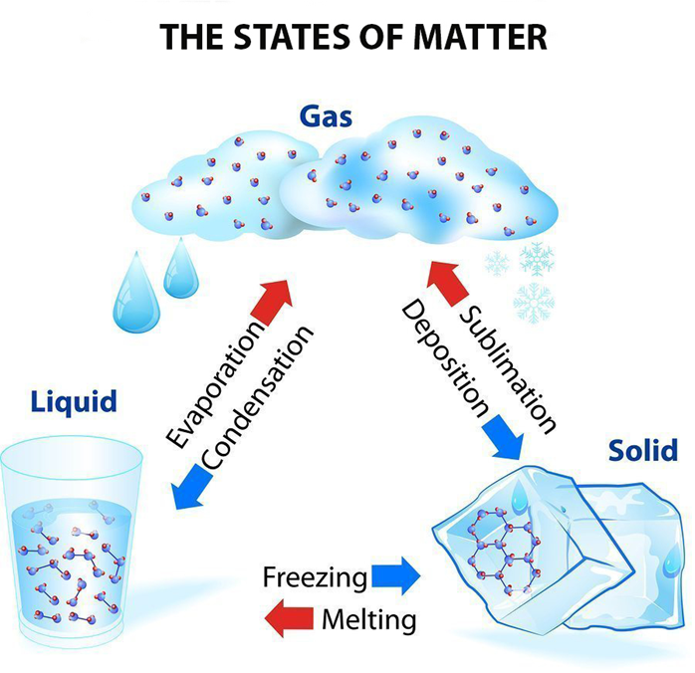
Calibration:
Thermometric Property:
A property used to measure temperature is termed a thermometric property. It must change linearly with temperature change and must sufficiently simple and accessible.
1, Expansion/Contraction, 2. Colour change, 3. Resistance change.
Mercury/Alcohl with red dye, are used in thermometers due to linear expansion, heat capacity and colour.
Standard Points:
Standard liquid Water is used for calibration; because it easily available, exists in three states: Solid(Ice), Liquid(water), Gas(Vapours/Steam).
Normally, two points are considered as standard points: Melting/Freezing (Lower Fixed Point) and Boiling/condensation(Upper Fixed Point) Under certain Pressure.
Mercury-in-glass thermometer:
Thermometers can be calibrated either by comparing them with other calibrated thermometers or by checking them against standard fixed points on the temperature scale.
A glass tube with a bulb and a capillary tube. The bulb(sensor) is filled with mercury/alcohl through capillary tube. The tube is evacuated and then sealed.

Slide 5
Calibration:
The traditional way of putting a scale on a liquid-in-glass or liquid-in-metal thermometer:
Immerse the sensing portion in a stirred mixture of pure ice and water at atmospheric pressure and mark the point indicated when it had come to thermal equilibrium(L.F.P.).
Immerse the sensing portion in a steam bath at standard atmospheric pressure and again mark the point indicated(U.F.P).
Divide the distance between these marks into equal portions according to the temperature scale being used.
These points(LFP &UFP) are chosen in the International Temperature Scale of 1990, though in practice the melting point of water is more commonly used than its triple point.
Now a days manufacturers will often use a thermostat bath or solid block where the temperature is held constant relative to a calibrated thermometer.
Other thermometers to be calibrated are put into the same bath or block and allowed to come to equilibrium, then the scale marked, or any deviation from the instrument scale recorded.
For many modern devices calibration will be stating some value to be used in processing an electronic signal to convert it to a temperature.

Slide 6
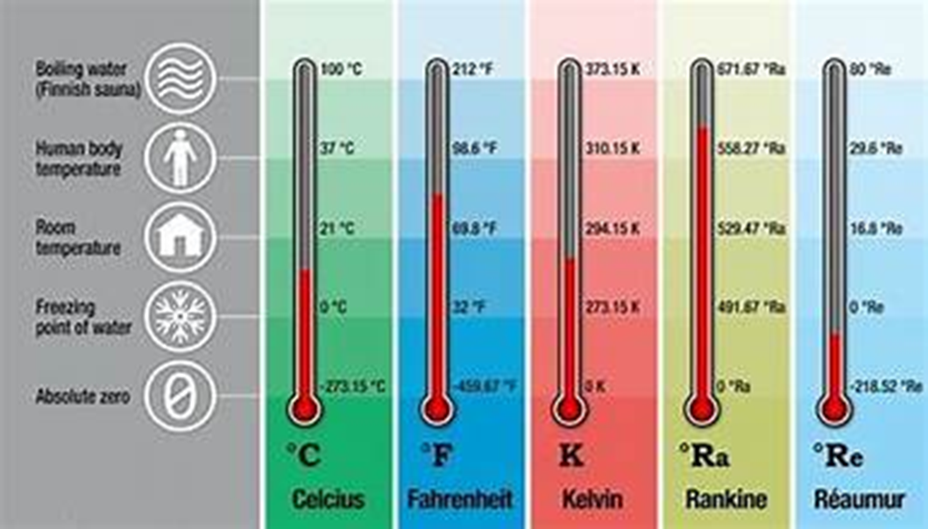
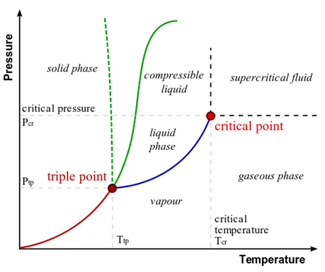
Temperature Scale:
The zeroth law of thermodynamics describes thermal equilibrium between thermodynamic systems in form of an equivalence relation.
Accordingly, For a quotient set, denoted as M, If M has the cardinality of c, then one can construct an injective function f : M → R, by which every thermal system has a parameter associated with it such that when two thermal systems have the same value of that parameter, they are in thermal equilibrium.
This parameter is the property of temperature. The specific way of assigning numerical values for temperature is establishing a scale of temperature. In practical terms, a temperature scale is always based on usually a single physical property of a simple thermodynamic system, called a thermometer, that defines a scaling function for mapping the temperature to the measurable thermometric parameter.
The Main Scales: 1. Empirical. 2. Ideal Gas, 3. International Temperature, 4. Thermodynamic.
There are five general temperature scales: Such temperature scales that are purely based on measurement are called empirical temperature scales.
These are the Celsius, Fahrenheit, Kelvin , Rankine and Reaumur scales.
The earliest of these is the Fahrenheit Scale invented by the German-Dutch scientist Gabriel Fahrenheit (1686-1736).

Slide 7
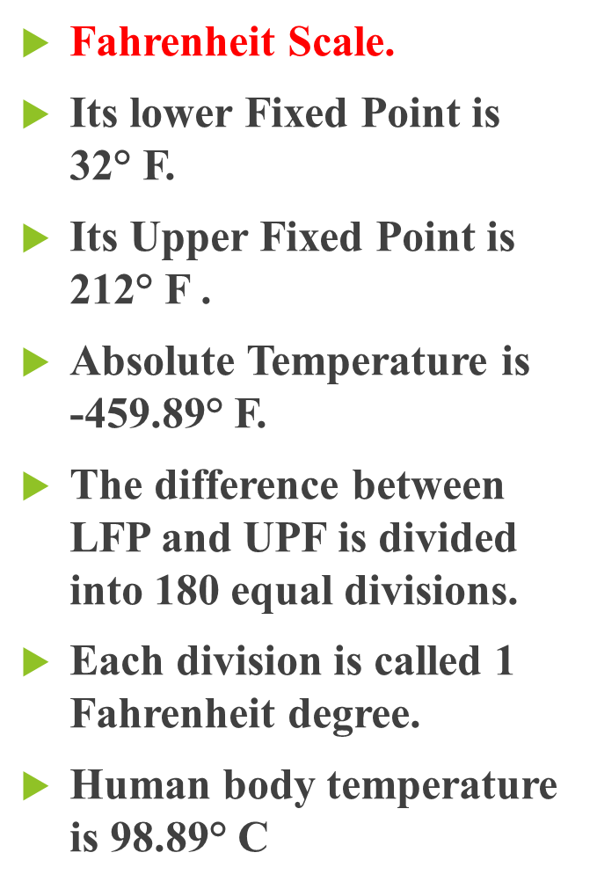


Temperature Scales:
Celsius Scale.
Its lower Fixed Point is 0$°$ C.
Its Upper Fixed Point is 100 °C.
Absolute Temperature is -273.16° C.
The difference between LFP and UPF is divided into 100 equal divisions.
Each division is called 1 Celsius degree.
Human body temperature is 37° C
Kelvin Scale.
Its lower Fixed Point is273.16 K.
Its Upper Fixed Point is 373 K .
Absolute Temperature is 0 K.
The difference between LFP and UPF is divided into 100 equal divisions.
Each division is called 1 kelvin.
Human body temperature is 310 K.

Slide 8
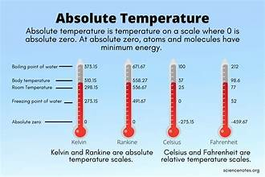

Relationship among Temperature Scale:
The three temperature scales are commonly used.
There is a relationship among them.
It is experimentally observed that the ratio of temperature difference between any two sales is always equal.
$\frac{Temperature Difference 1}{Difference in Standard Temperature}=\frac{Temperature Difference 2}{Difference in Standard Temperature}$
$\frac{Tc−LFP}{UPF−LFP}=\frac{Tf−LFP}{UFP−LFP}=\frac{Tk−LFP}{UFP−LFP}$
$\frac{Tc−0}{100−0}=\frac{Tf−32}{212−32}=\frac{Tk−273}{373−273}$
$\frac{Tc}{100}=\frac{Tf−32}{180}=\frac{Tk−273}{100}$
$\frac{Tc}{5}=\frac{Tf−32}{9}=\frac{Tk−273}{5}$
$\frac{Tc}{5}=\frac{Tf−32}{9}$ $\frac{Tf−32}{9}=\frac{Tk−273}{5}$ $Tc=Tk−273$

Slide 9
Applications
Thermometers utilize a range of physical effects to measure temperature.
Temperature sensors are used in a wide variety of scientific and engineering applications, especially measurement systems.
Temperature systems are primarily either electrical or mechanical, occasionally inseparable from the system which they control (as in the case of a mercury-in-glass thermometer).
Thermometers are used in roadways in cold weather climates to help determine if icing conditions exist.
Indoors, thermistors are used in climate control systems such as air conditioners, freezers, heaters, refrigerators, and water heaters.
Galileo thermometers are used to measure indoor air temperature, due to their limited measurement range.
liquid crystal thermometers (which use thermochromic liquid crystals) are also used in mood rings and used to measure the temperature of water in fish tanks.
Fiber Bragg grating temperature sensors are used in nuclear power facilities to monitor reactor core temperatures and avoid the possibility of nuclear meltdowns.

Slide 10
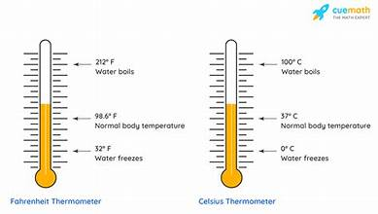
Conceptual Thermodynamics:
Why do thermometers have two scales on them?
With these two markings placed upon the thermometer, 100 equally spaced divisions can be placed between them to represent the 1-degree marks. Since there is a linear relationship between the temperature and the height of the liquid, the divisions between 0 degree and 100 degree can be equally spaced.
How does a thermometer measure temperature?
The actual measurement measures the actual temperature of a specific region at a specific moment by mercury thermometers or by automatic electronic thermometers. The thermometer is placed on a body surface until the temperature does not change any more or reaches the thermal equilibrium stable temperature.
What is a transducer & instrumentation in thermometry?
There are two main parts, transducer and instrumentation, in this kind of thermometry. A transducer converts heat energy or temperature into other forms of energy. An instrument processes the converted quantity to make it visible and legible on a temperature scale.
Why are direct and indirect measurements important?
Both direct and indirect measurements are important for understanding the true scale of climate change. Many different types of scientists study how things in the natural world are affected by or respond to changes in climate.
The End

